Slide 1

Initialization technique
Li Kun
20185104

Slide 2
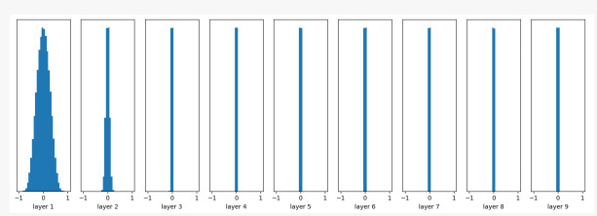
Initializaiton
Why we need to initialize the data?
Model:
10 layers
Active function: tanh
Parameters of each layer: Normal distribution
Average: 0
Standard variance: 0.01
Why should we initialize the data?
The following figure shows the histogram of the distribution of output valus of each layer.

Slide 3
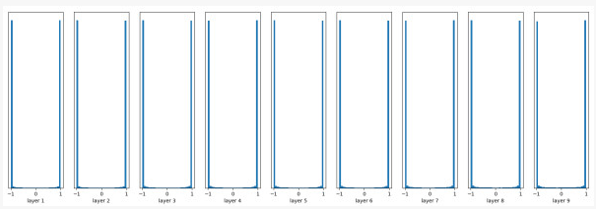
Initializaiton
Why we need to initialize the data?
If we turn the initial value up a bit:
The mean is still 0, and the standard deviation now becomes 1. The following figure is a histogram of the distribution of output values for each layer:
Why should we initialize the data?

Slide 4
Initializaiton
Why we need to initialize the data?
To solve this problem, I will introduce two initialization methods:
(1) Xavier initialization
(2) He initialization
Why should we initialize the data?
Baisc ideas:
Xavier initialization try to Keep the variance of the input and output consistent, thus avoiding all output values tending to zero.
He initialization is :in the RELU network, it is assumed that half of the neurons in each layer are activated and the other half is 0. Therefore, to keep the variance constant, it is only necessary to divide by 2 on the basis of the economy.

Slide 5
Xavier initialization
Related theorem
Suppose there are random variables x and weights w, which all obey a distribution with a mean of 0 and a variance of σ, and are independent and identically distributed, then:
w*x will obey the distribution with a mean of 0 and a variance of σ*σ.
w*x+w*x will obey the distribution with a mean of 0 and a variance of 2*σ*σ.
Assumption
(1)For a active function f(x), f’(x)=1.(for example tanh()).
(2)Assume that all input data x and parameter w satisfy the distribution with a mean of 0 and variance σ.
(3) Suppose the input x and the weight w are independently and identically distributed.

Slide 6
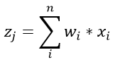
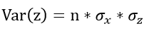
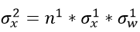
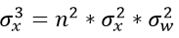
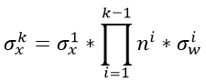
Xavier initialization
Proving process (forward propagation)
For an active function,f(x)=x(ignore the bisas), f’(x)=1.(for example tanh()).
Output of the j layer is:
Since w and x are independently and identically distributed
then
……
K is the label of the layer
All in all

Slide 7
Xavier initialization
If n^{i}*ẟ^{i}_{W}>1, what’s the result?
If n^{i}*ẟ^{i}_{W}<1, what’s the result?

Slide 8
Xavier initialization
If n^{i}*ẟ^{i}_{W}>1, what’s the result?
As the number of layers is deeper, the variance of the values will become larger and larger.
If n^{i}*ẟ^{i}_{W}<1, what’s the result?
As the number of layers is deeper, the variance of the values will become smaller and smaller.

Slide 9
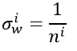
Xavier initialization
Solution
For any i-th layer, to ensure that the variance of the input and output is consistent, you need to meet:

Slide 10
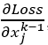
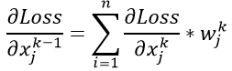
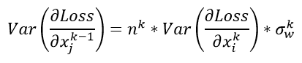
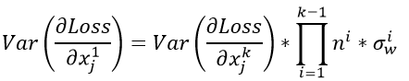
Xavier initialization
Proving process (backward propagation)
Suppose we are still a k-layer network, now we have the gradient of the kth layer
then for the gradient of the k-1th layer input, there is
(1)
(2)
(3)

Slide 11
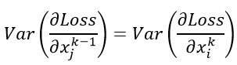
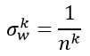
Xavier initialization
Proving process (backward propagation)
We want to be numerically stable, so that the values before and after backpropagation are subject to a stable distribution:
Then you need to meet the following conditions:

Slide 12
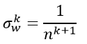
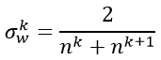
Xavier initialization
forward propagation:
backward propagation:
So in order to balance considerations, our weight variance should eventually satisfy:

Slide 13
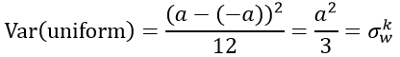
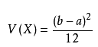
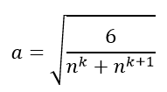
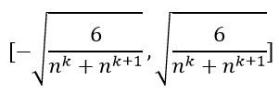
Xavier initialization
The range of important initialization of our set weight is [-a, a]. The evenly distributed variance is:
Since
We can get:
The parameters are initialized to a uniform distribution within the following range:

Slide 14
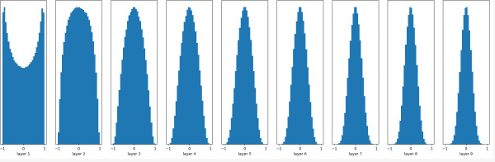
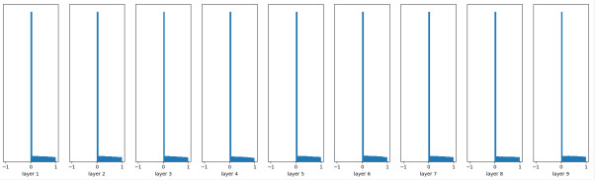
Result
Xavier initialization
He initialization

